Slide 1

COM410 Programming in Practice

Slide 2


Reach Out
Email:
serif.salem@qa.com
Serif Refined Material (Password: COM410)
https://tinyurl.com/QACOM410
University Drop Box
https://tinyurl.com/QAULSTER

Slide 3
Recap (Queues and Stacks) Case Study - Playing Cards

Slide 4
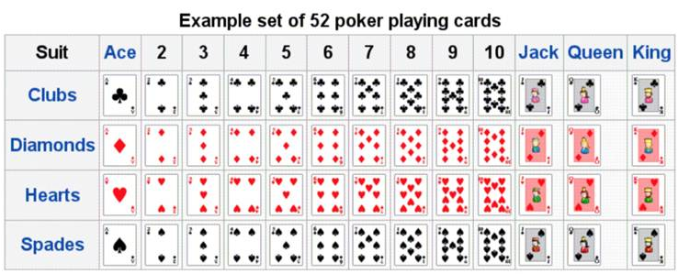
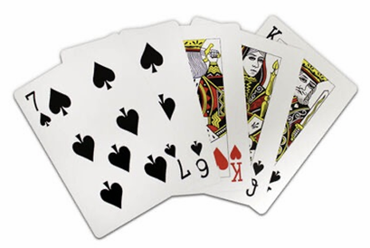
Case Study – Playing Cards
Playing cards provide an excellent example of an ADT that can support multiple applications
Suit (Hearts, Spades, Clubs, Diamonds)
Rank (2, 3, 4, …, Queen, King, Ace)
Value (2, 3, 4, …, 9, 10, 10, 10, 10, 11)
Rank Value (e.g. 0, 1, 2, …, 10, 11, 12)
Colour
Face up/face down
Collection of cards can be a deck (1 only?)
Collection of cards can be a hand (multiple?)
Cards behave differently in different situations (Snap, Poker, Bridge, etc.)
Standard operations – deal, shuffle, compare, etc

Slide 5
Scenario – Playing Card (Lab)
In your DataStructures project, implement a Card class to represent a single standard playing card.
A card is characterised by 2 values
Its rank (one of “2”, “3”, “4”, “5”, ”6”, “7”, “8”, “9”, “10”, “Jack”, “Queen”, “King”, “Ace”)
Its suit (one of “Clubs”, “Diamonds”, “Hearts”, “Spades”)
Include the following public methods on Card objects
A Card() constructor to generate a card with random rank and suit values
Accessor methods getRank() and getSuit() to return the rank and suit
A toString() method to return the card in the form (e.g.) “2 of Clubs”
A method isBiggerThan() that takes another Card object as a parameter and returns true if the card has a higher rank than the parameter card.
Implement a CardTest class to generate 2 new cards and display them biggest first

Slide 6
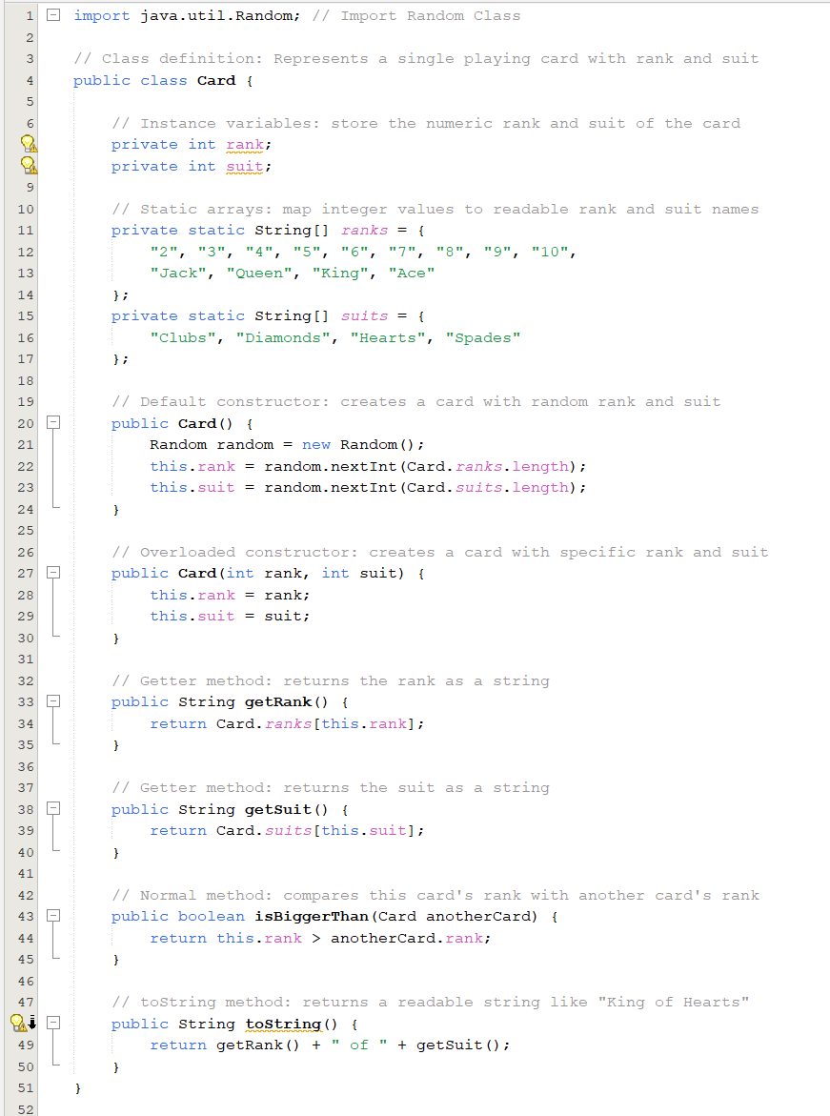
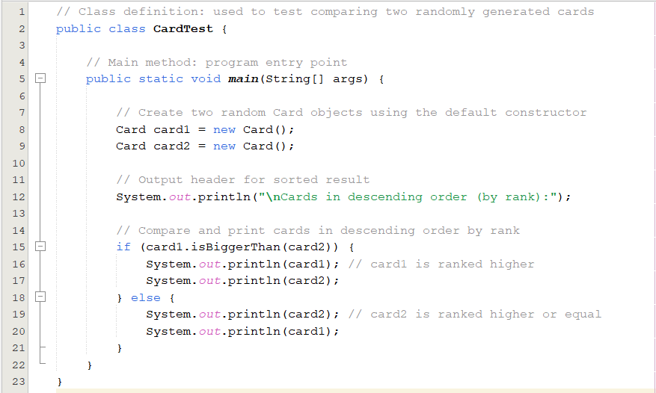
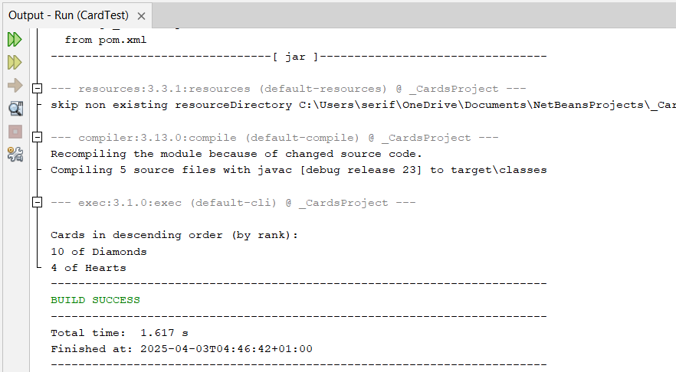

Slide 7
Scenario – Playing Card (Lab)
In your DataStructures project, create the class Deck to represent a full pack of 52 Card objects.
Provide a method toString() The deck should create one of each combination of suit and rank. You will also need to create an overloaded Card constructor that accepts rank and suit parameter values.
Provide a method toString() that returns a string representation of the deck, with each card printed on a separate line.
Provide a method deal() that returns a Card object and removes it from the deck
In the CardTest class, provide code to create a deck, print it, and deal and print 5 cards
Provide a method shuffle() that randomizes the order of the cards in the deck
In the CardTest class, demonstrate that the shuffle has had an effect by creating a deck and printing it to the console.

Slide 8
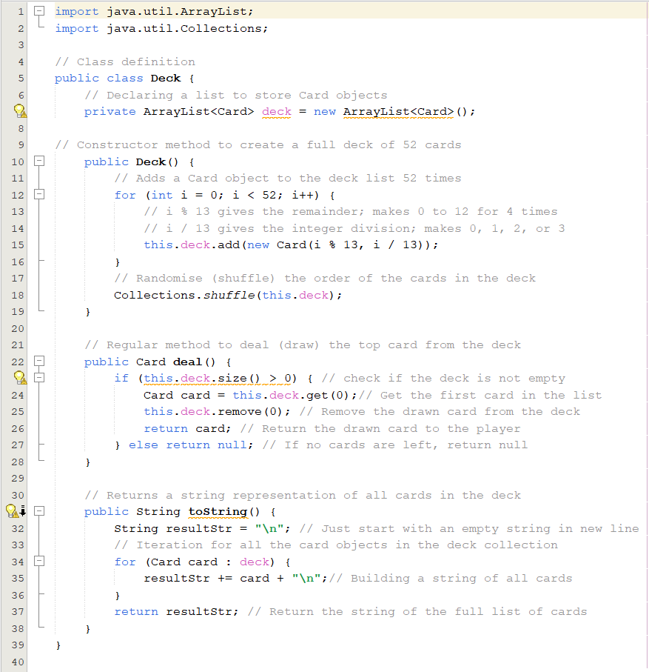
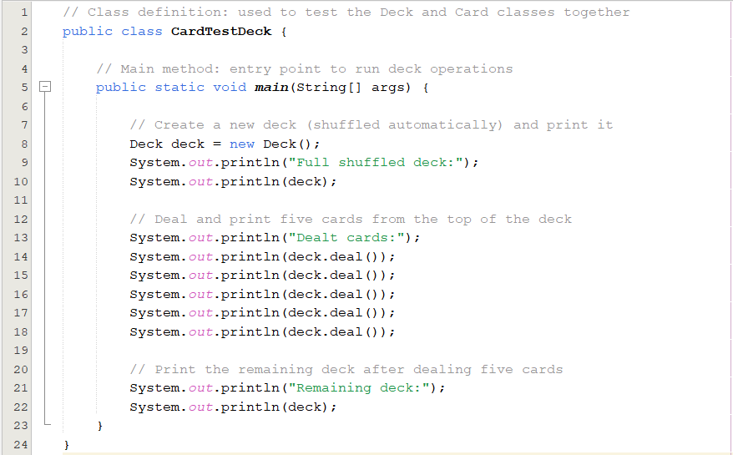
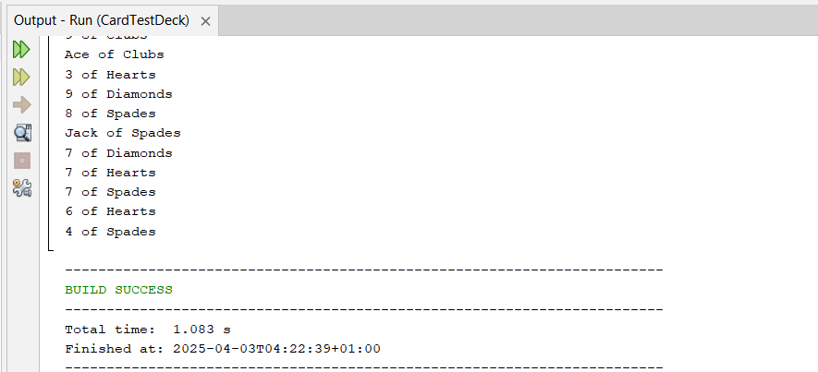

Slide 9
Sorting

Slide 10
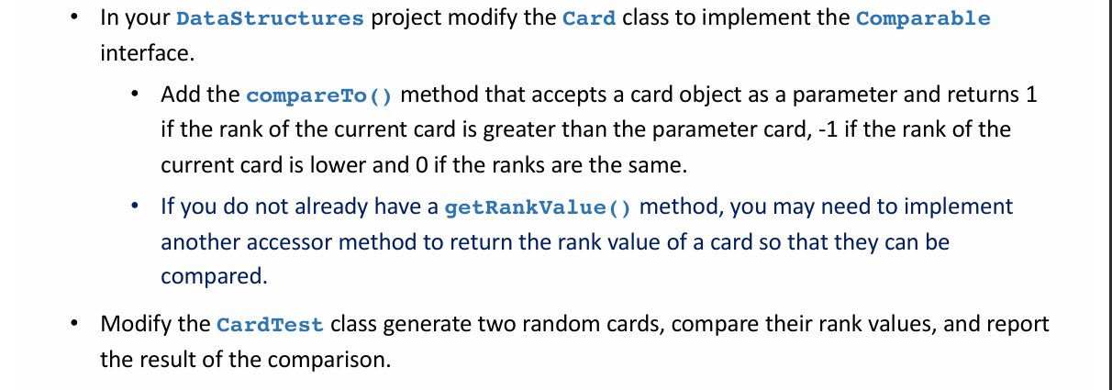
Scenario – Comparing Cards (Lab)

Slide 11
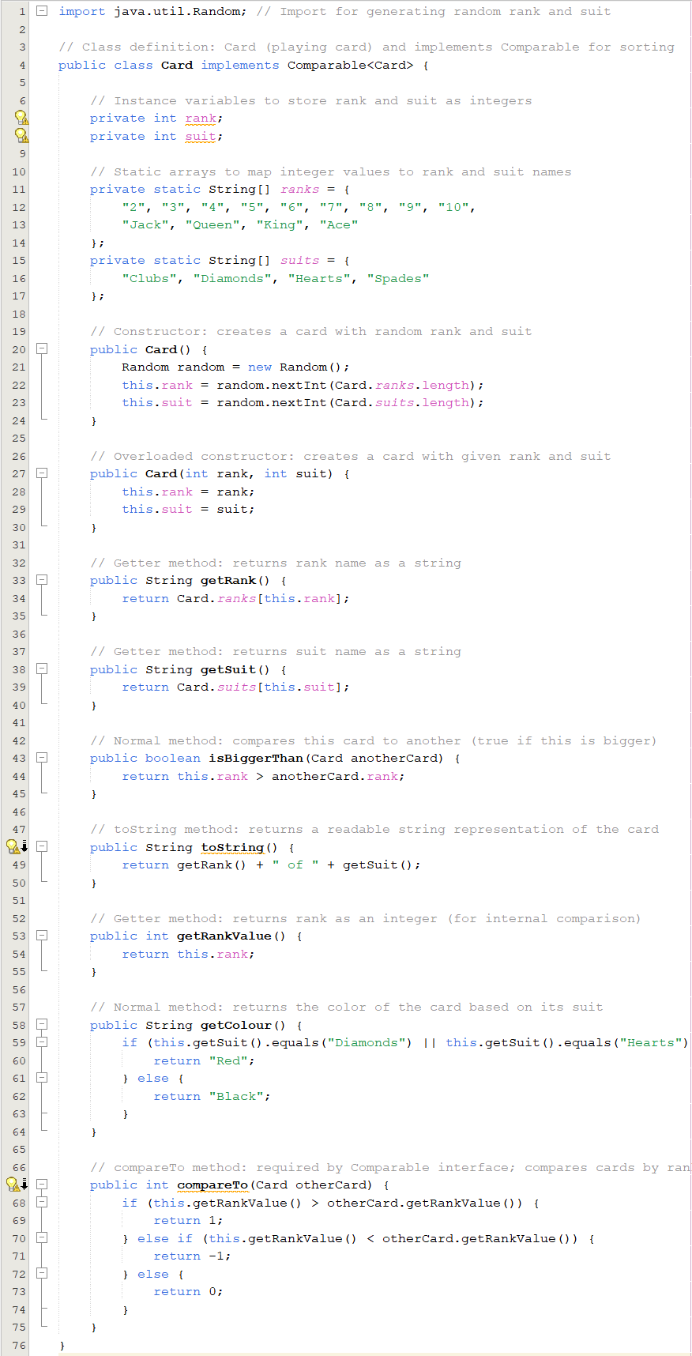

Slide 12
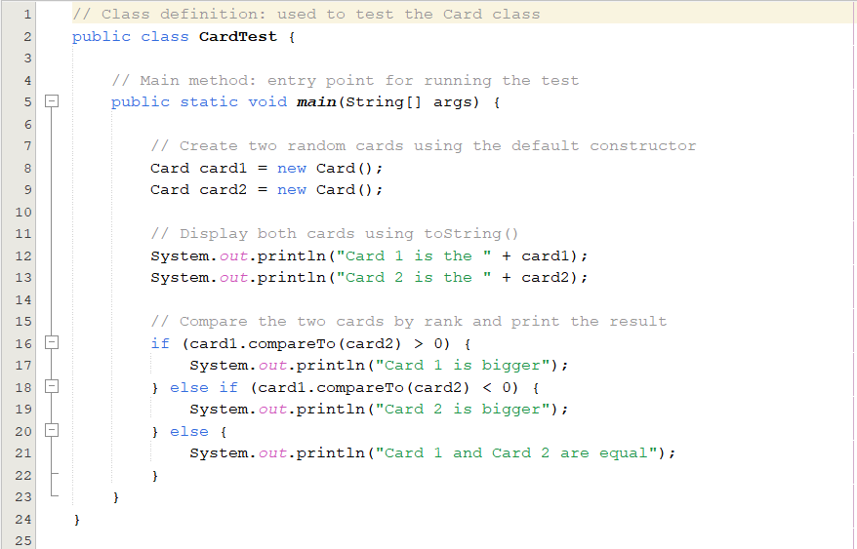
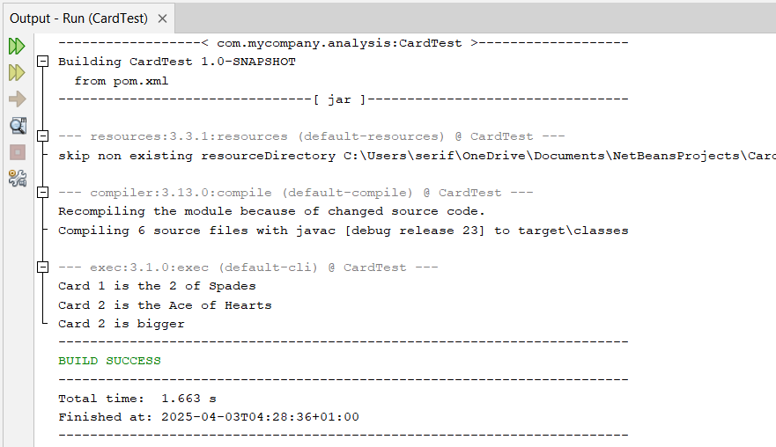

Slide 13
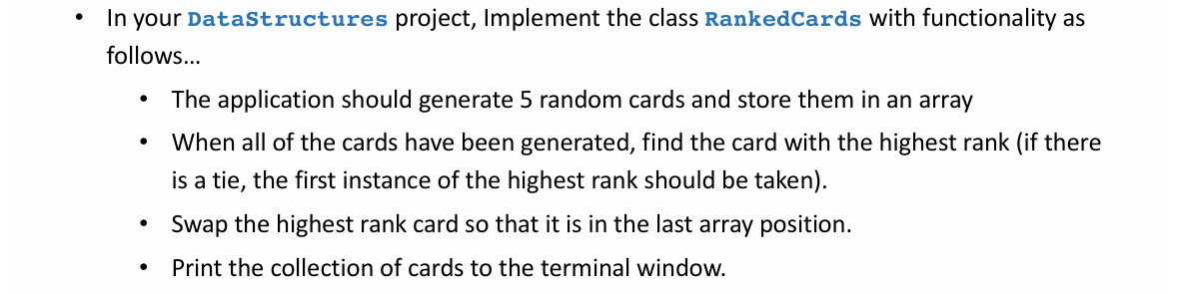
Scenario – Manipulating Cards (Lab)

Slide 14
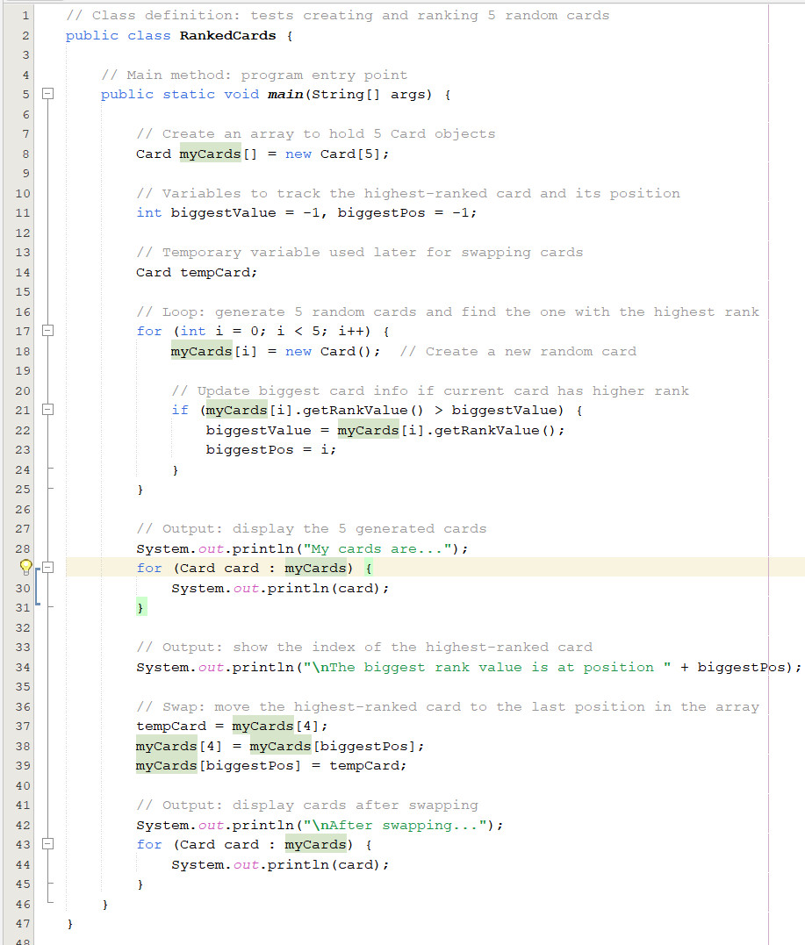
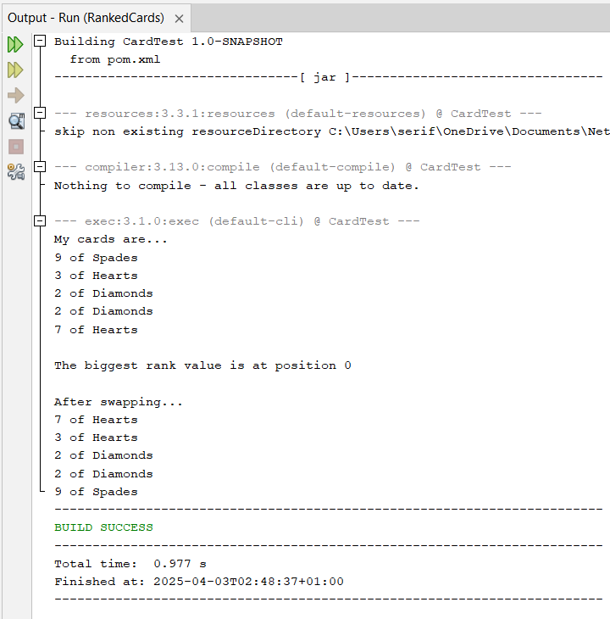

Slide 15
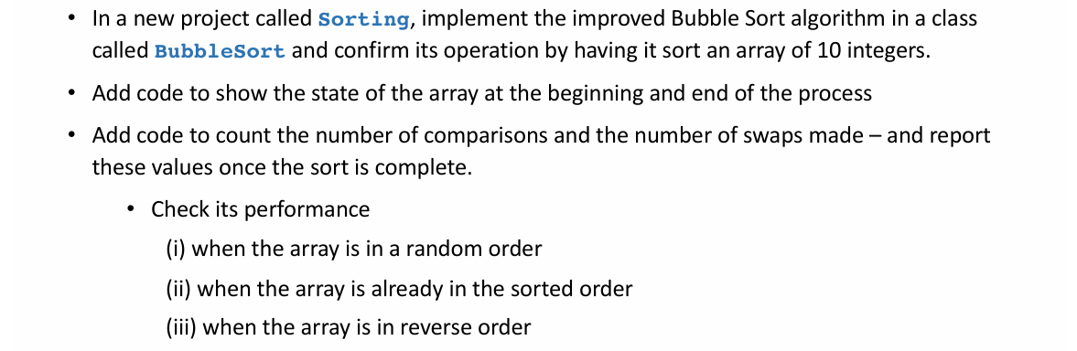
Scenario (Lab)

Slide 16
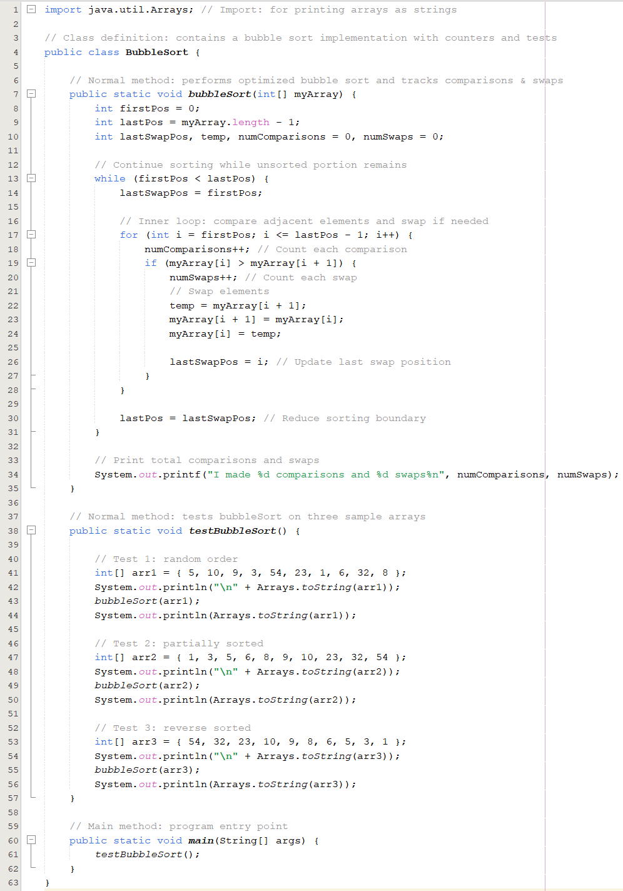
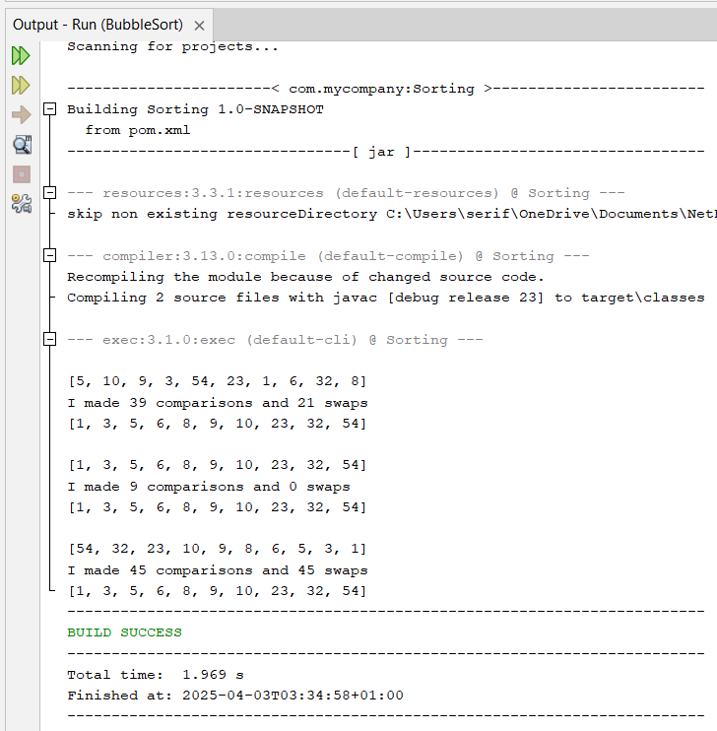

Slide 17
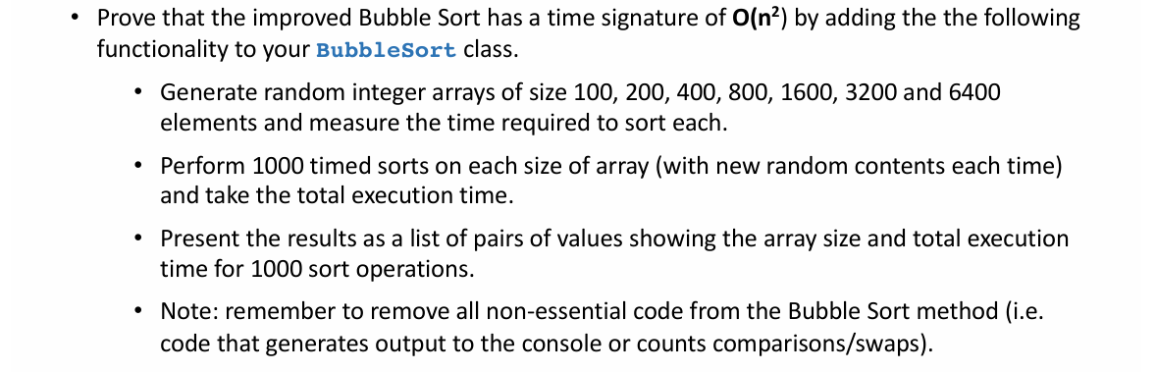
Scenario (Lab)

Slide 18
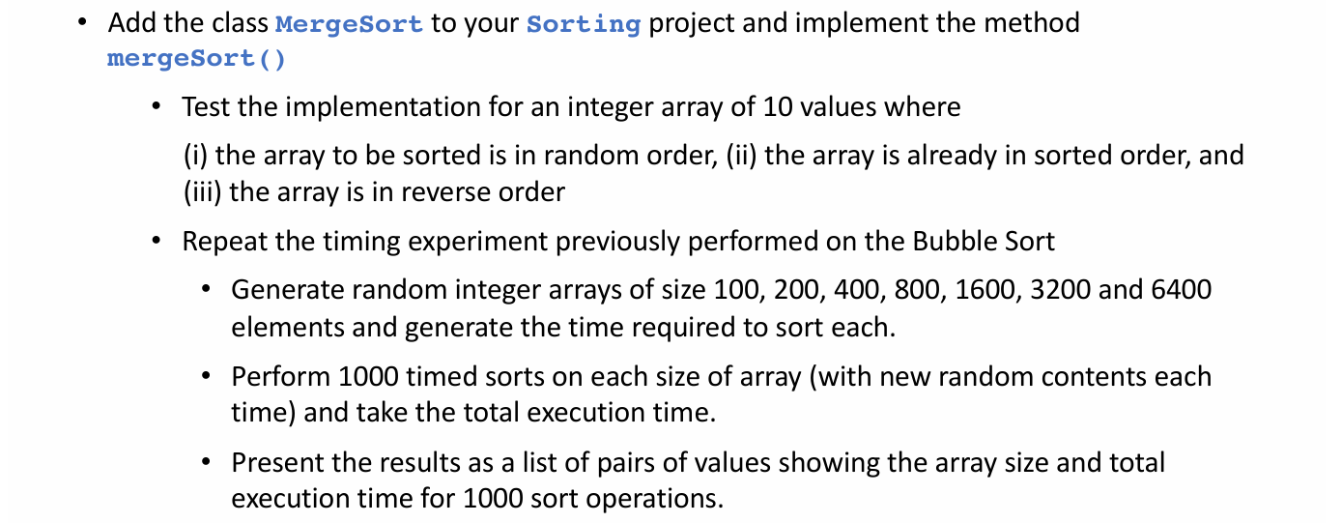
Scenario (Lab)

Slide 19
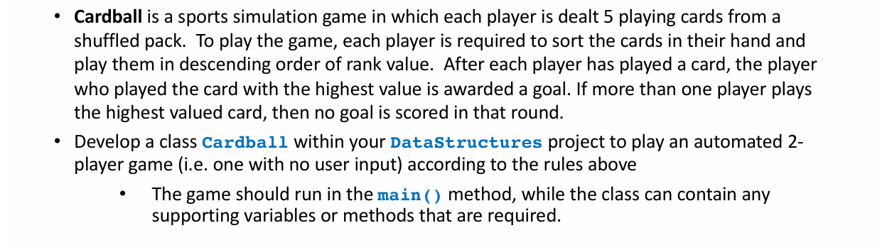
Challenge (Self Practice)

Slide 20
